Slide 1
Customer Complaint Classification using Word2Vec and SVM
Making MRI machines more Reliable
Sunil Mandhan
Nov 06, 2019

Slide 2
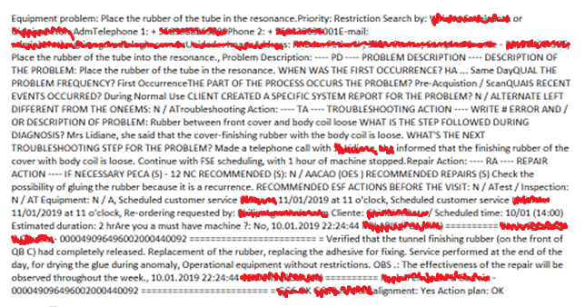
1. Background
We have cases logged by customers, can you tell if they belong to SW or HW
And then, Can you tell us different categories in HW and SW they belong to:
HW-PatientHandling
HW-RFCoils
SW-Recon
SW-UserWorkflow
ApplicationSupport
ServiceSupport
etc.
But why
we want to improve the reliability of the systems
Ok, we also need to find the problem areas and the root causes of the areas
Yes, we have that process already, called 5 whys.
Ok got it.

Slide 3
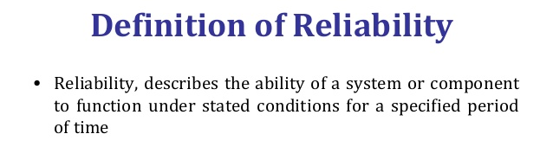
2. Problem Statement
Why we are doing this
Reliability improvement in MR machines (HW + SW + Workflow + Support)
Target - Reliability improvement in Design
During design – focus on failure modes, Fish bones
From field feedback – Failure modes etc.
Still getting
Customer complaints - ?
Why
Because we didn’t capture the possible scenarios and failure modes
We didn’t follow the design and validation process.
What we are doing
Subsystem classification
Failure or problem area identification

Slide 4
3. Approaches
Data Sources – Cases from customer complaints database
N-gram with classif. models (SVM, RF, NB, etc.)
1-gram
2-gram
1 + 2 gram
1 + 2 + 3 gram
How to capture the contextual info
Word embeddings
Word2Vec
but how to capture max contexts
Take whatever can give contexts like
prod. Manuals,
all the relevant cases(~1M cases)
FAQ documents
Website scrapping
Problem
doesn’t capture all the context, just words
Accuracy was low around ~60%
Limited number of feature words (less training data ~2k samples)
Poor SVM and RF performance - missing words in test data

Slide 5
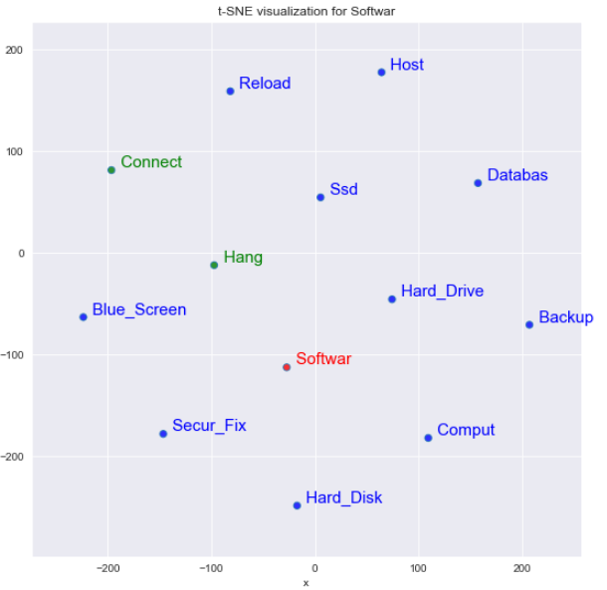
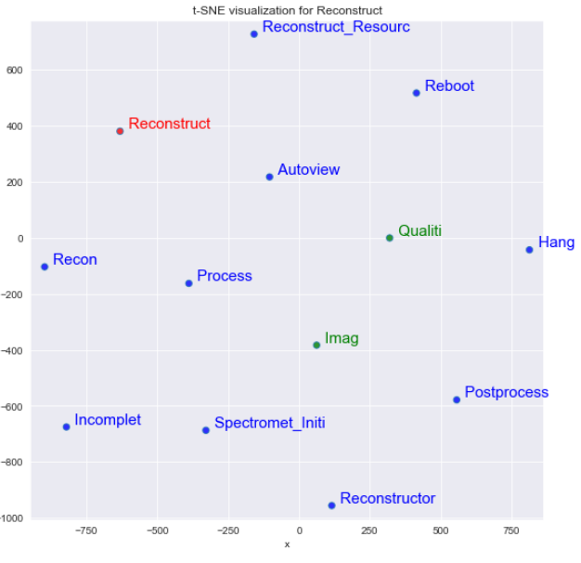
4. Why Word2Vec
There are other approaches also based on deep learning like LSTM based features.
Wanted to try simple approach first as it capture enough context
Sometimes problem understanding and formulation is more important than selecting a complex approach.

Slide 6
5. How it works
Readymade Word2Vec models available on web doesn’t work in MRI context as
they miss MRI specific words and their contexts and some domain words specific to Manufacturer
We needed word2vec model built for MRI domain
let's build it
but how
Take all the cases (~1M)
Take product manuals, take FAQs, Websites
Clean the data, get phrases, give it to word2vec

Slide 7
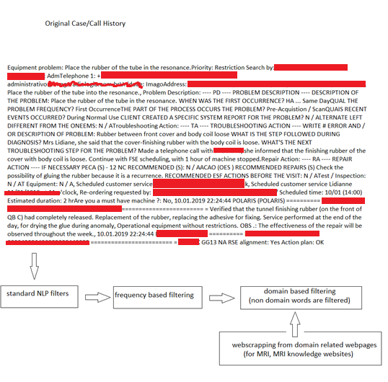
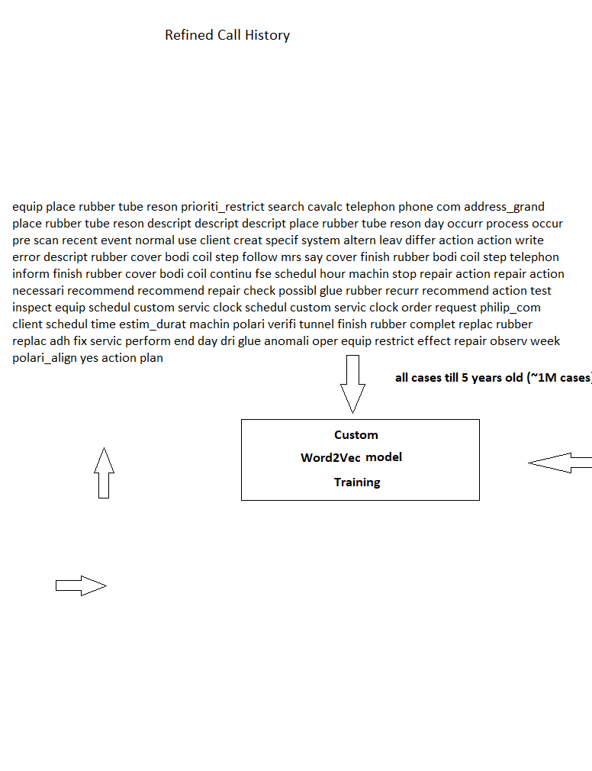
6. Custom Word2Vec training
Product manuals
FAQs
Challenge – People, Date, time, event, etc. removal using NER

Slide 8
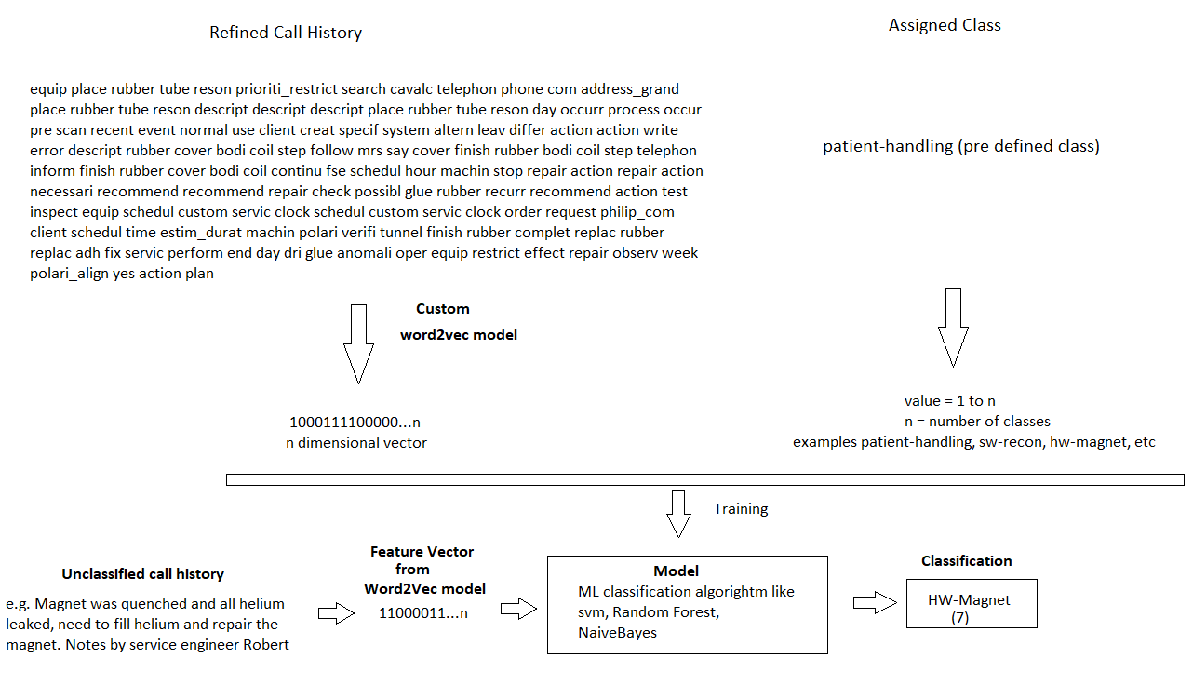
7. Classification Model Building

Slide 9
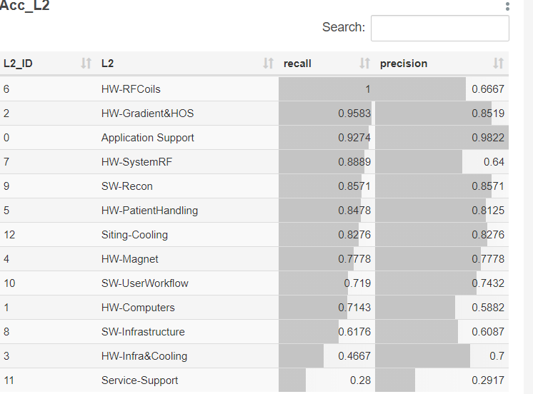
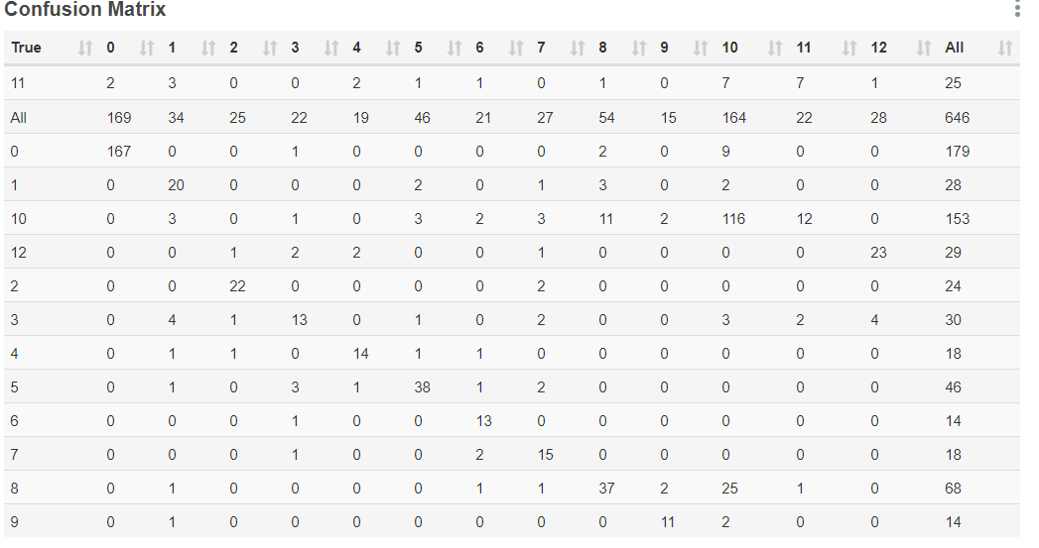
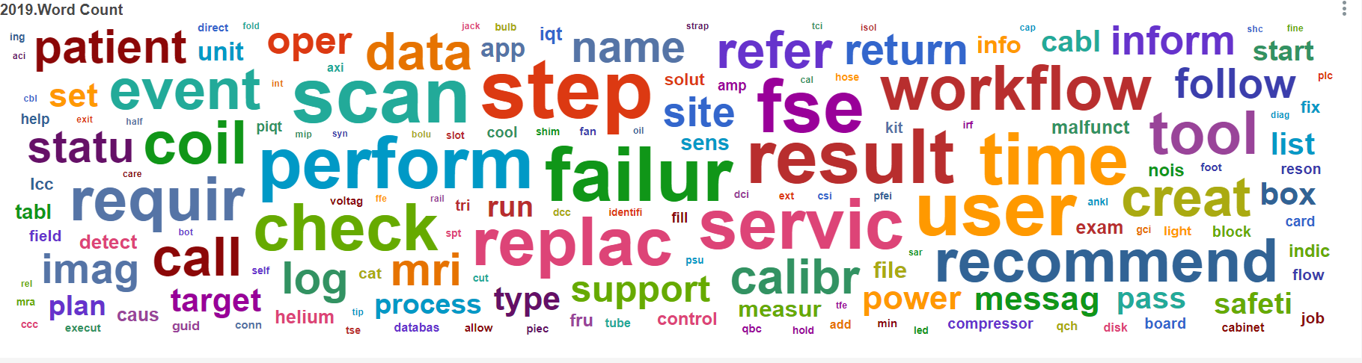
Accuracy
Test data accuracy 78%
10-fold cross validation

Slide 10
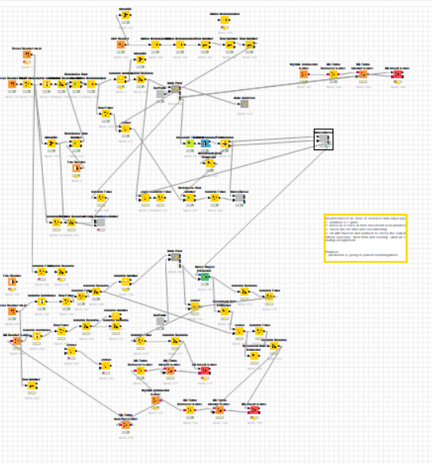
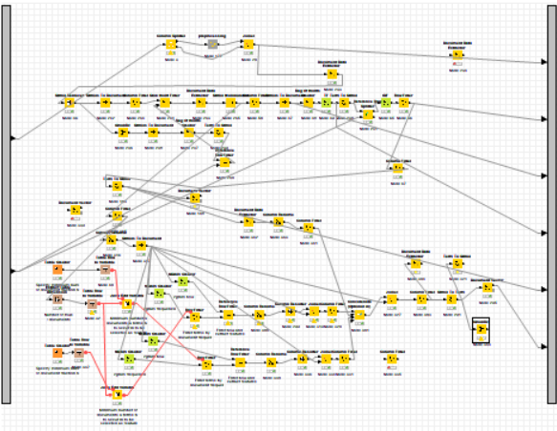
Accuracy with other approaches
Naïve Bayes
1 gram
2 gram etc.
Test data accuracy
63%
Poor accuracy on
sw cases < 40%

Slide 11
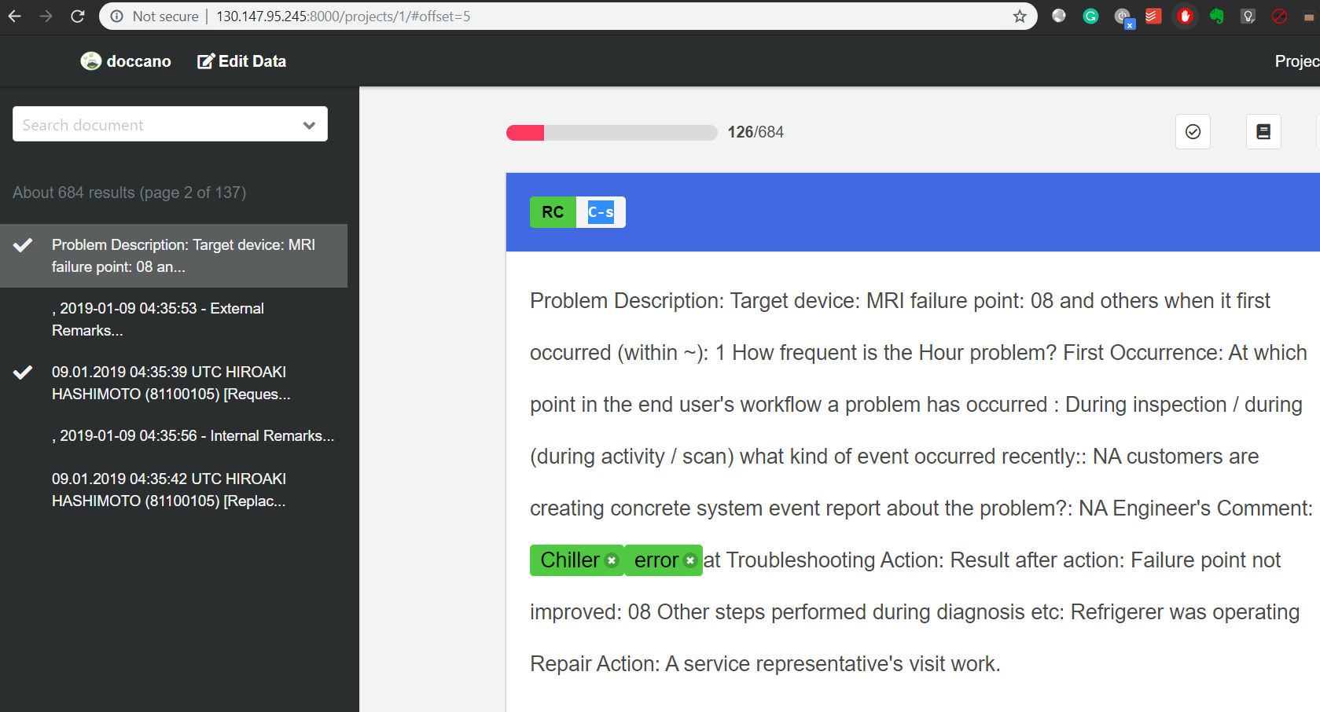
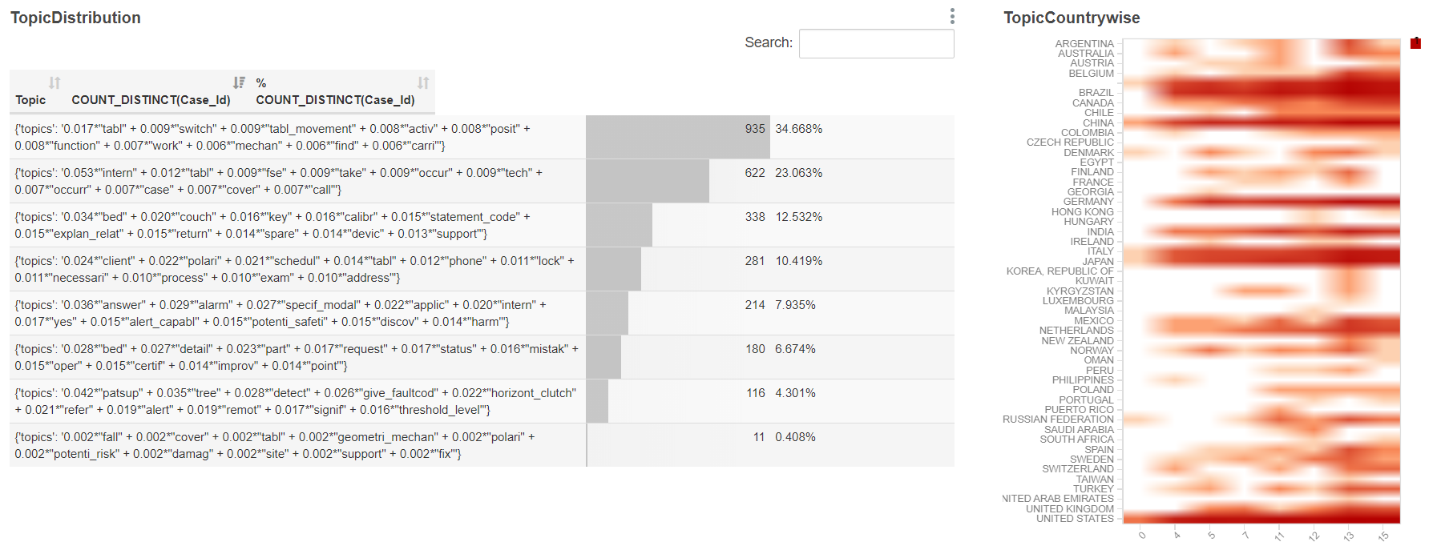
L3 Prediction
Doccano tool for annotation
CRF based approach
Data annot. Using Doccano. Good results
but annotation of samples needed
is time consuming.
Topic Modeling
Good result but very generalized directions. Specifics need to be worked out again.

Slide 12
Tools Used
Python (core)
Scikit-learn (svm),
Gensim (Word2Vec, LDA)
Spacy (nlp pipeline)
Pentaho Data Integration (Opensource ETL)
MySQL
Apache Superset (Opensource BI tool)
On Docker with Kubernetes
Knime
Docker & Kubernetes (for Superset)

